Slide 1


Optimal Sensor Placement in Fluid Dynamics using Machine Learning and Sensitivity Analysis
Harley Hanes¹, Yury Lebedev², Alina Zare², Ralph C. Smith¹
¹North Carolina State University, ²University of Florida
AIAA SciTech Forum
01/25/23

Slide 2
Overview
Shallow encoders as reduced-order models (ROMs) for fluids
Sensitivity analysis for optimal sensor placement
Sensor sensitivity for lid-driven cavity
Conclusions and future work

Slide 3
Shallow Encoders as Reduced-Order Models for Fluids
Shallow encoders are a simple machine learning neural network
Inputs: Velocity data from sensors
Outputs: Entire velocity field
Can approximate flow from experimental data
Requires initial training data
Notes:
Machine learning
Inputs: sensor data
Outputs: flow-field at that same time
Pre-determined structure
Train network from set of high-fidelity sensor data
Direct from data
POD-ROM constructs flow-field from flow-fields
Requires initial high-fidelity simulations but can approximate other time steps or parameters
Direct from sensor data allows ROM evaluation from sensor data
Allows a ROM that can be solved directly from experimental data to better condition high fidelity solutions
Cons
Requires initial data to train

Slide 4
Shallow Encoders are Accurate ROMs
8% Error
Accurate and quick to solve
Notes:
Left is sample velocity data and blue is sensor locations
Right is velocity reconstruction from trained network
Visibly accurate reconstruction, only missing some complexity in velocity at bottom of cavity
Benefits
Reasonably Accurate (8% error)
Computationally efficient to get solve (less than a second compared to solving ODE for POD-ROM)
Cons
Training has computational cost
Solutions don’t necesarily satisfy initial equations like Navier-Stokes

Slide 5
Sensors are Placed Using SVD of Flow Data
Machine learning provides a direct from sensor-data ROM
How do we identify sensor locations?
Use leverage scores for initial sensor position
Identify where to place additional physical sensors
Notes:
Placement: Assume some initial sensor placement, we use leverage scores for this circumstance but method is agnostic to initial placement
Initial placement: Leverage scores
Construct snapshot matrix Y
Compute SVD decomposition
Select cells that have maximal variance in right singular vectors
Goal: identify where to place additional sensors to improve accuracy

Slide 6
Mutual Information is Computationally Expensive
Mutual information methods optimize parameters under uncertainty in inputs and outputs
Requirements
Uncertainty prediction of outputs
Iterative integral solving
Predicting entire flow-fields
Training network at every step
K. Schmidt, et al. (2018). Optimal Positioning of Mobile Sensors using Mutual Information. Statistical Analysis and Data Mining, 12(6).
.
Notes:
MI optimize parameters under assumed uncertainty in inputs and outputs
Iteratively selects sensor locations given previous sensors to minimize error
Needs uncertainty predictions on entire outputs space
Needs to iteratively solve integrals over the uncertainty in inputs and outputs
TRANSITION
Domain is entire flow-field (thousands or millions of dimensions)
Integral approximation requires repeated retraining of network

Slide 7
Sensitivity Analysis Quantifies Influence of Parameters
Sensitivity analysis quantifies variation in outputs apportioned to variation in parameters
Mean Squared Error:
Measure sensitivity of error to sensor data and location
Data sensitivity: whether current location is an accurate predictor
Location sensitivity: whether nearby locations are accurate predictors
Notes:
SA quantiifes ...
Output is MSE
Transition
Data: Low sensitivity means network doesn't change if values there changes, i.e. that data doesn't predict flow-field well
High sensitivity means network does, i.e. data does predict flow-field well
Location: Low sensitivity means nearby positions have impact of network

Slide 8
Measure Sensitivity With Derivative Approximations
Location: Morris Screening
Data: Network Sensitivity
Sensitivity:
Magnitude:
Variance:
Notes:
Both use partial derivatives to measure sensitivity
Use mean absolute value to counteract cancellation in signs (relationships often nonlinear, if one parameter value decreases by 100 and another increases 100 the sensitivity shouldn't be zero)
Variance measures how nonlinear, can identify if a small number of sensor locations or values have a much larger effect

Slide 9
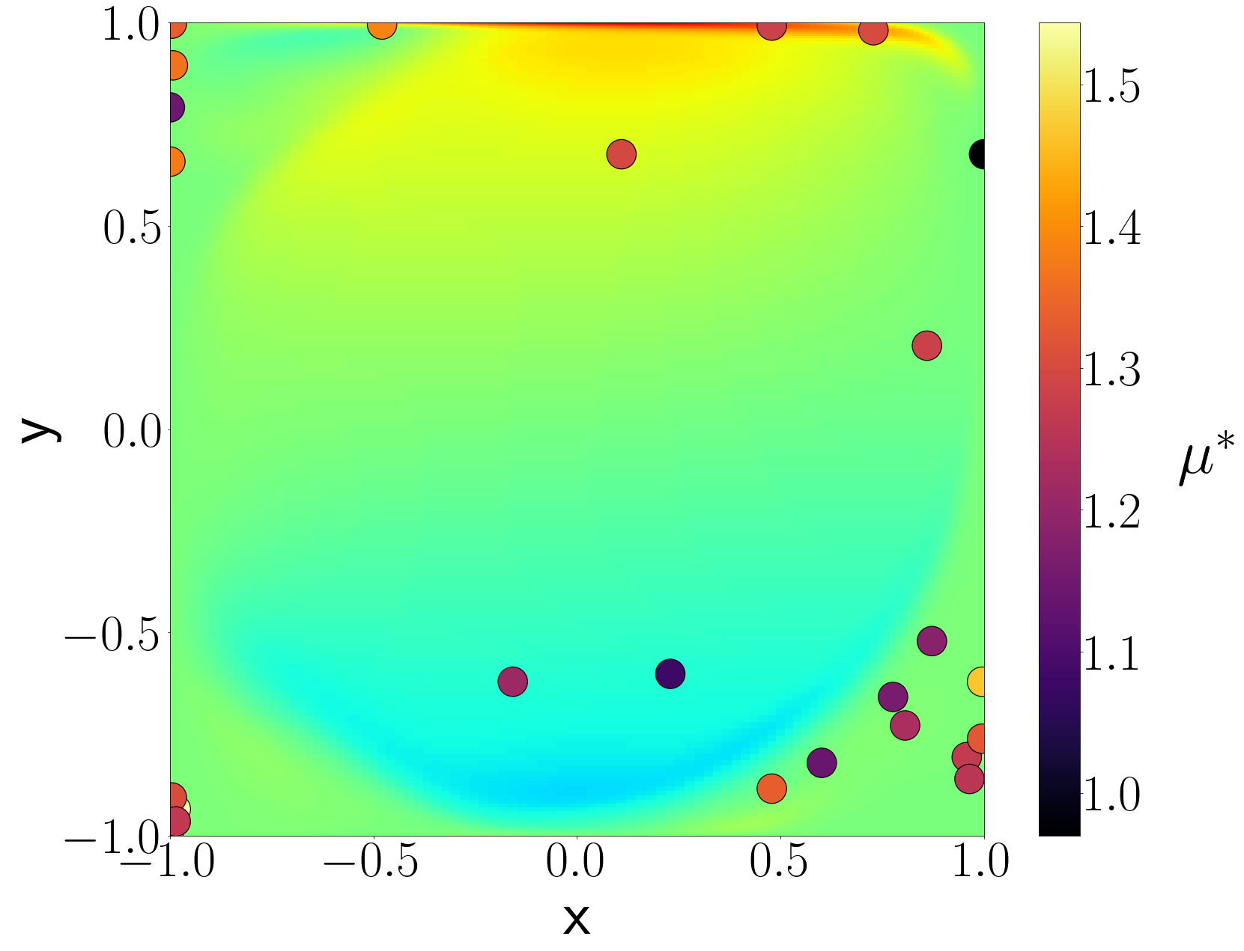
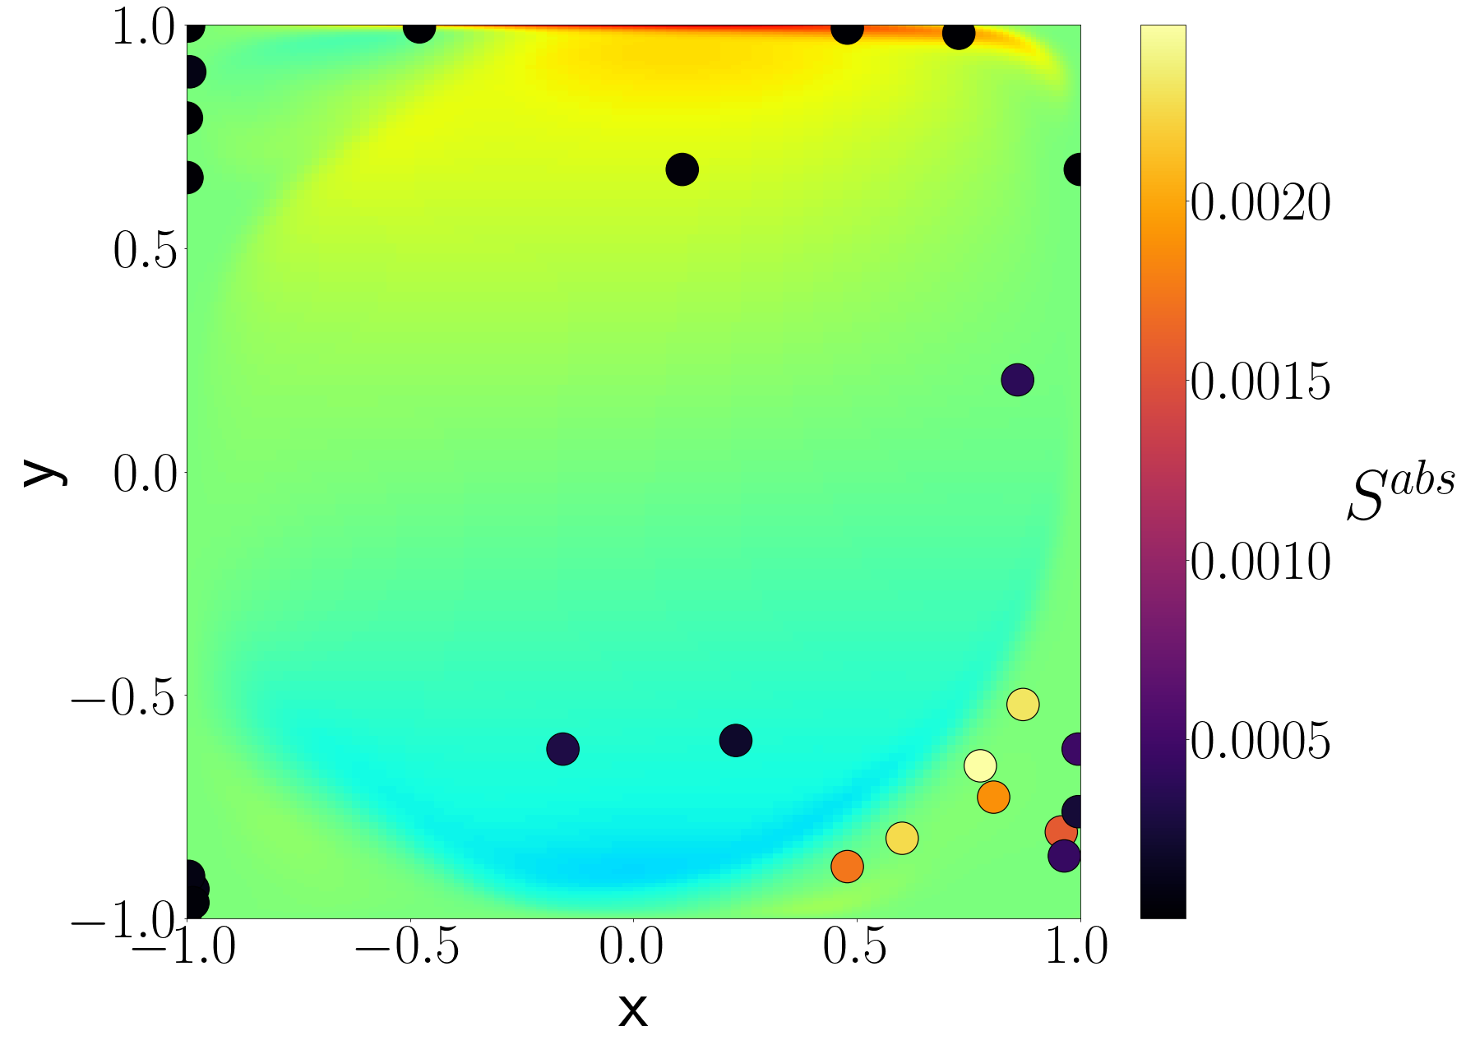
Bottom-right is Most Sensitive Region
Location Sensitivity
Data Sensitivity
Error insensitive to data in top left
Notes:
Left is sensitivity to location, right is sensitivity to data
Location has much higher sensitivity and all sensors are sensitivity
Data has many sensors with near zero-sensitivity (i.e. network doesn't use them much to compute reconstructions
Transition
Similar agreement between sensitivity to data and location
Highest: Bottom right corner
-says sensor position matters here but network primarily computes reconstruction using just this region
Transition
Top right has high locations sensitivity but low data sensitivity
means that
-adjusting these sensor positions has effect on error
-current positions aren't helpful in computing reconstruction
Therefore: likely place to put additional sensors, probably near main rotational flow

Slide 10

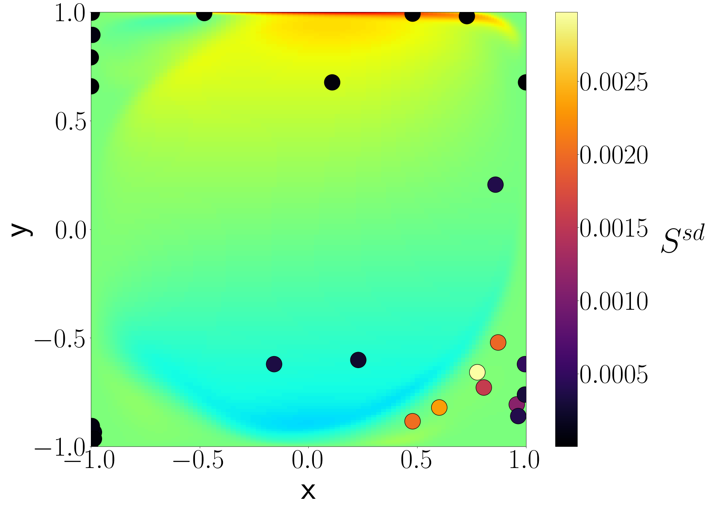
Standard Deviation of Error Sensitivity
High standard deviations of sensitivity for both location and data
Top-left is best location for additional sensors
Notes:
High standard deviation
Reason for high variation: All sensors increase and decreases accuracy with adjustment, so mean is about 0,
TRANSITION
High standard deviation for location confirms top right is best place for additional sensor

Slide 11
Conclusions
Shallow encoders are an accurate, efficient ROM for fluid models
Sensitivity analysis can inform sensor placement when other methods are too expensive
Top-left of flow is optimal location for additional sensors
Network has low sensitivity to most sensor data.

Slide 12
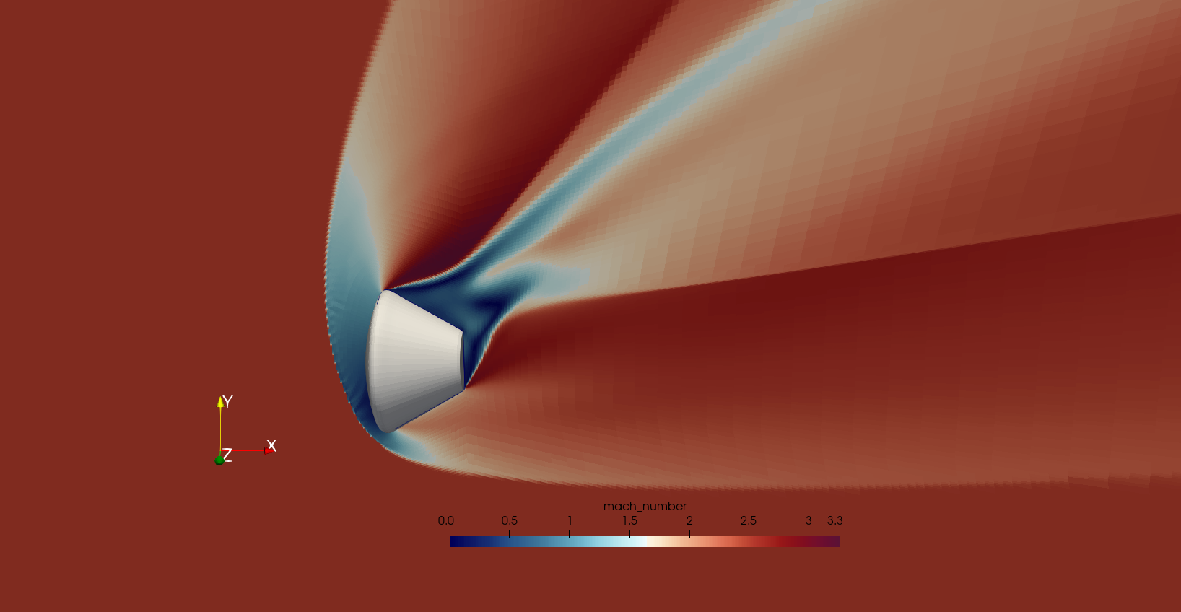
Future Work
Sensitivity analysis can identify flow regions to place additional sensors for fluid approximation
Next Step: Identify optimal sensor placement on Orion Mars lander.
Notes:
Start from initial set of experimental sensors
train network to compute flow-field reconstructions of flow
identify where to put additional sensors for future experiments to improve those reconstructions

